Slide 1


Tracking Coronavirus
By Kevin Chow

Slide 2

Main Idea
Track social interactions between people to determine who would most likely catch the virus.

Slide 3
Influence Graph
Influence graph as underlying structure
Vertex represents a person
Direct weighted edges represents the level of physical interaction
Java

Slide 4
Implementation
User prompted to input a number of people to test,
User prompted to input a number of people that is infected.
User prompted to decide if the infected people have social distanced.
Output the randomly chosen infected people and the likely infected people.

Slide 5
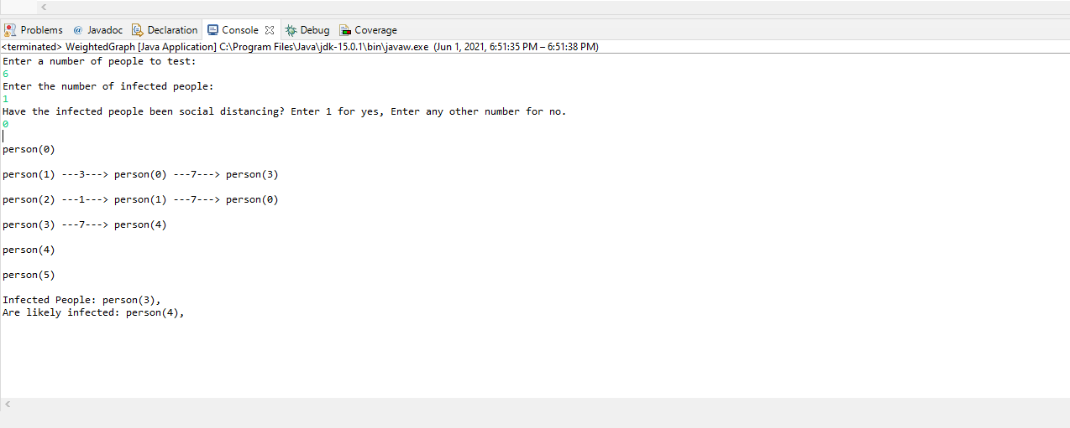
Example 1

Slide 6
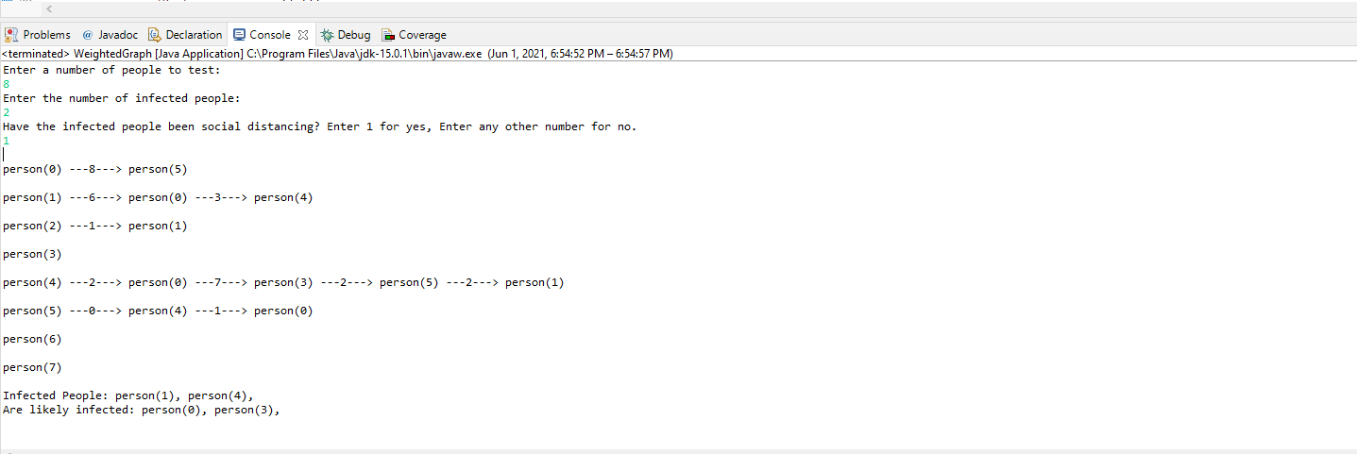
Example 2

Slide 7

Thank you!

